Slide 1


Investment Recommendation System Providing Personalized Financial Insights
Capstone Project - 2 November 2024
Vinitha Sampathkumar
Education:
Master of International Business, DR.G.R. Damodaran College of Science (2018 – 2020)
Bachelor of Business Administration, PSGR Krishnammal College(2015 – 2018)
Experience:
Research Analyst at Vaave Alumni Management Company (2021-2022)
Market Research Analyst at Zinnov Consultancy (2020-2021)

Slide 2
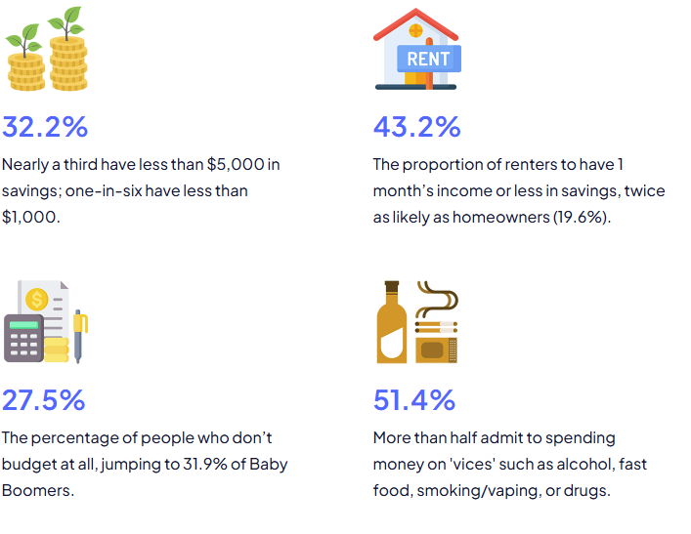
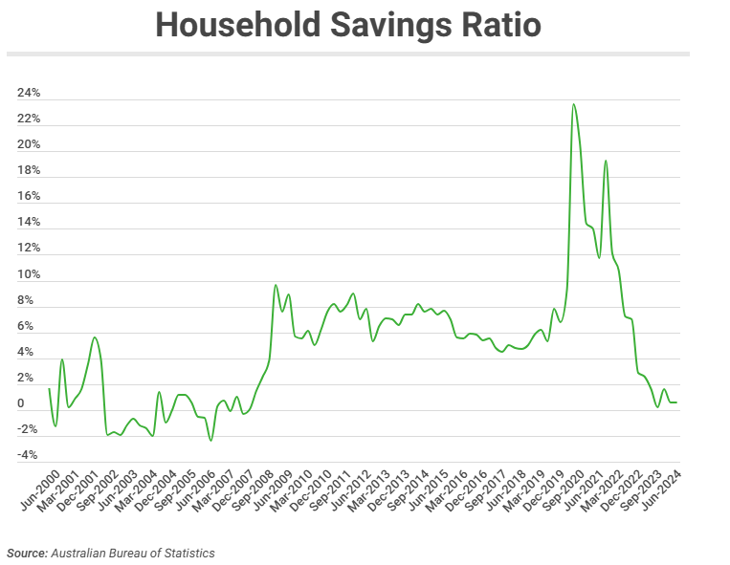
How much does the average Australian save?

Slide 3

Agenda:
Overview
Business Problem
Exploring Data Analysis
Model Approach and Evaluation
Deployment and Practical Applications
Future Work and Improvements
Conclusion

Slide 4
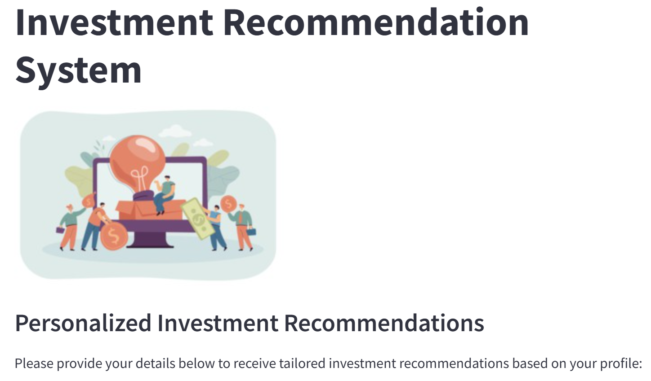

Problem Statement:
Many individuals lack personalized guidance in making investment decisions. There is a need for an automated system that caters to diverse financial backgrounds and goals.
How can personalized investment recommendations be automated to aid individual financial decision-making?
Impact:
Financial planning affects individuals' economic security. Improved recommendations can enhance decision-making, leading to better financial outcomes.
Objective:
To develop a model that provides personalized investment options based on user demographics, goals, and financial behavior.

Slide 5
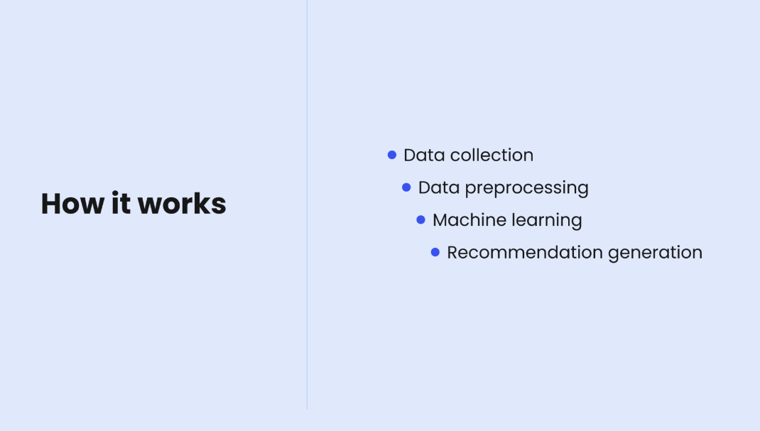



Project Context:
A real-time investment recommendation system built with Python and Machine Learning for beginners and intermediate users to invest in various popular Investment options such as
Stock Market
US market
Australia
Gold futures
Real Estate recommendation - NSW
Key Components:
Data Collection: Utilizing financial data from various sources.
User Profiling: Analysing user demographics and financial situations.
Recommendation Engine: Providing tailored investment recommendations.
Market Analysis: Incorporating live data for real-time insights.
Data Sources:

Slide 6
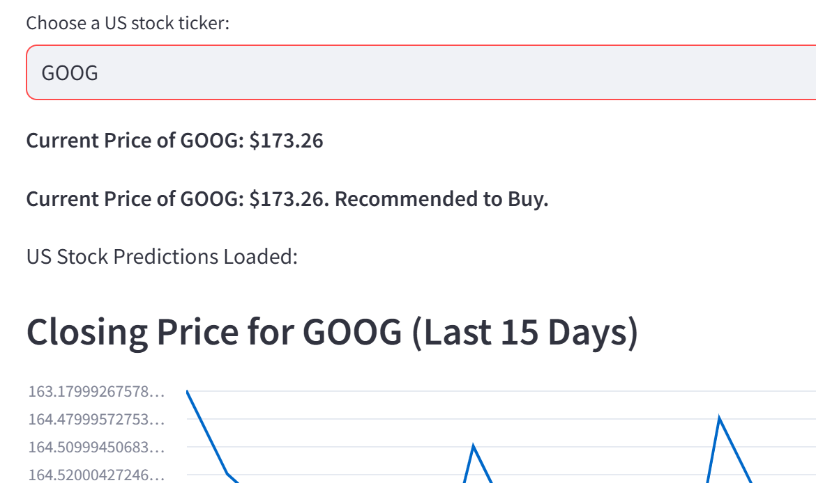
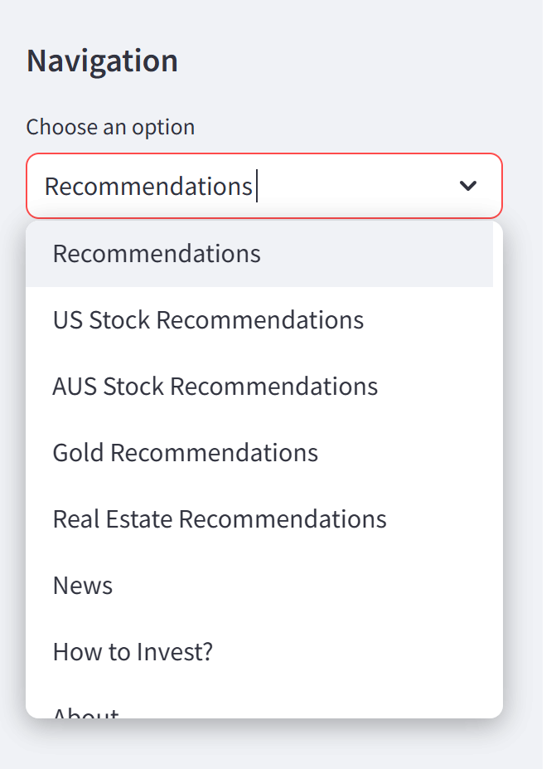

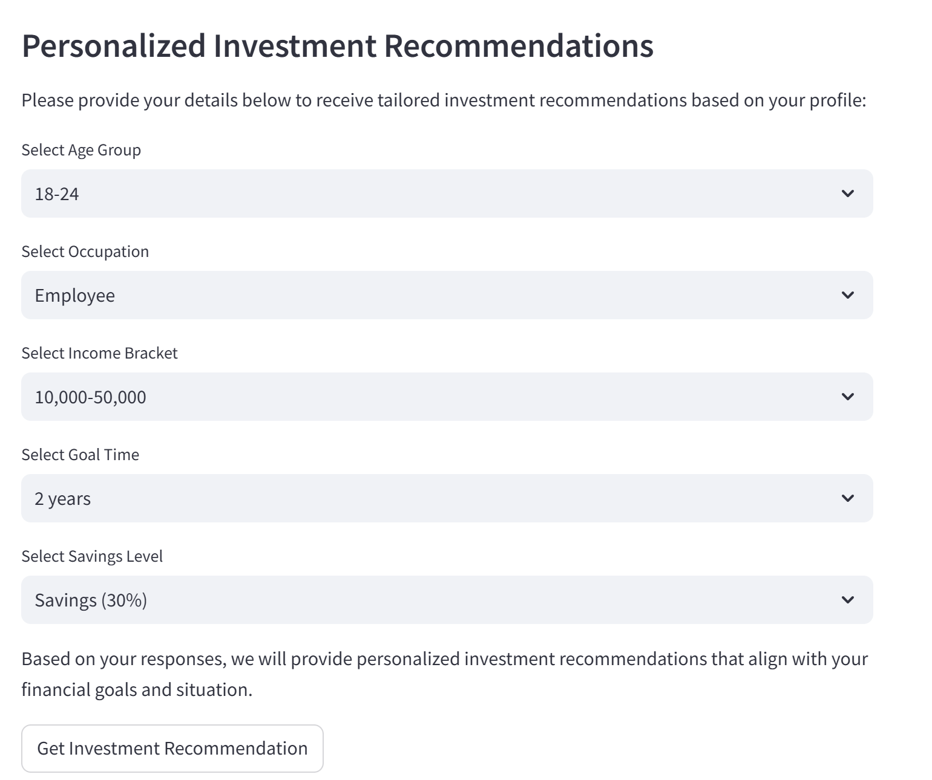
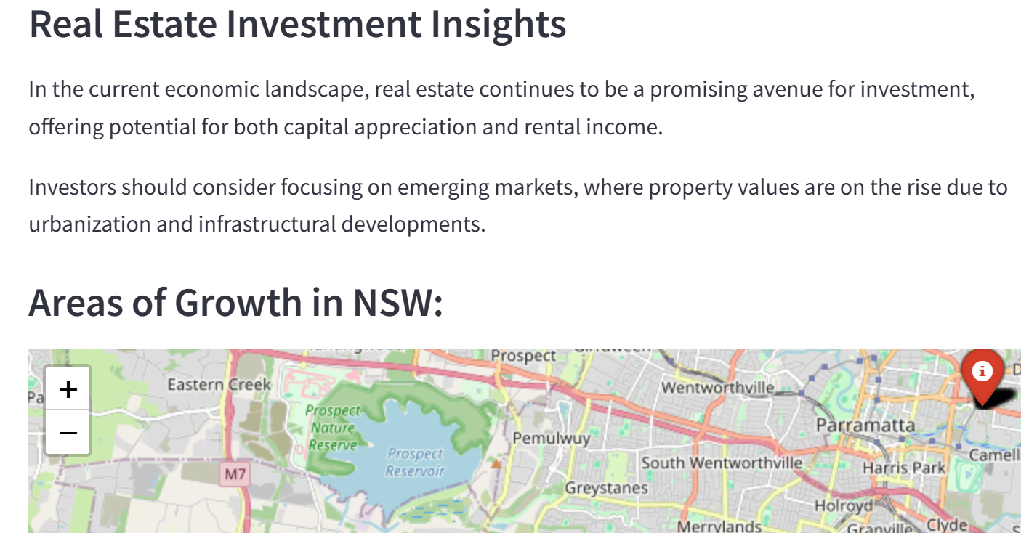


Slide 7
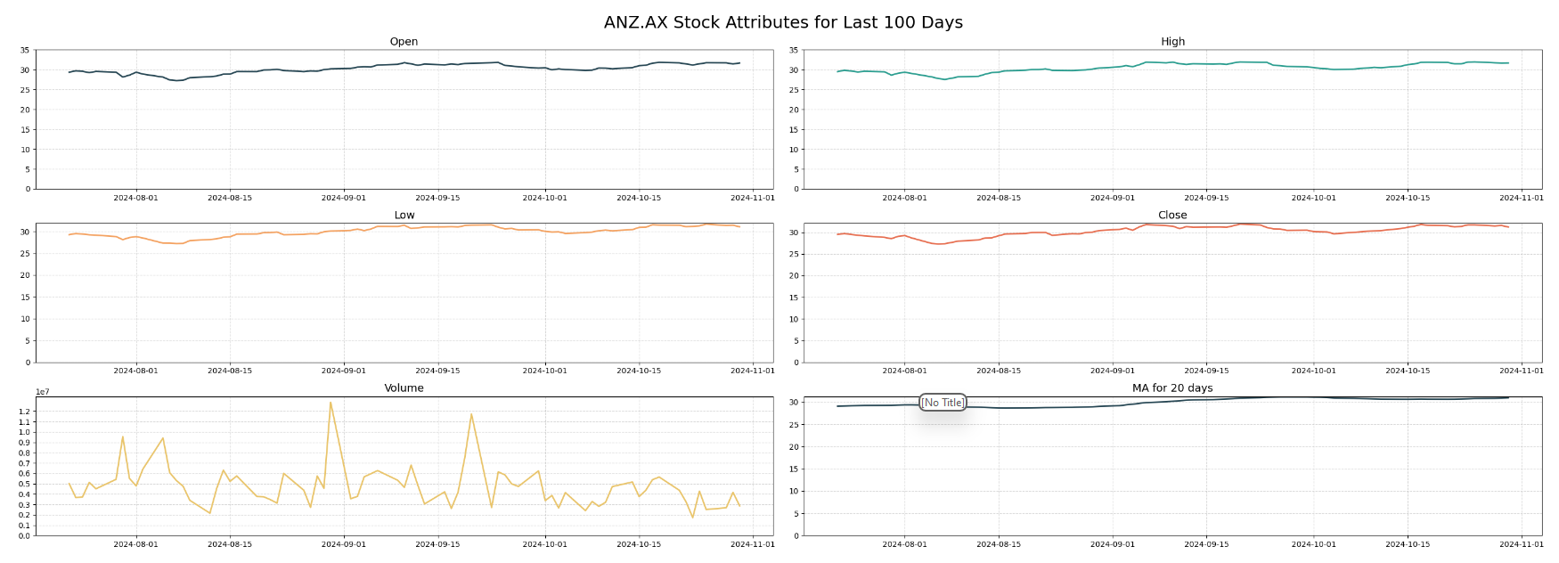
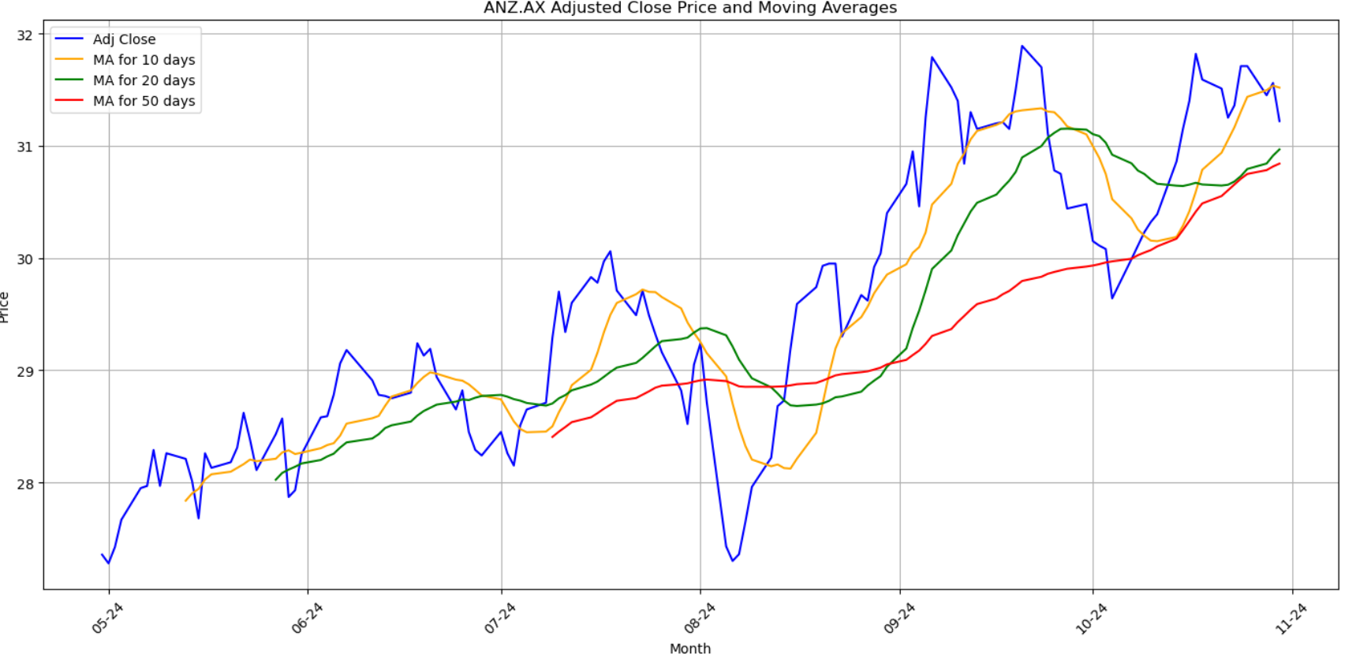
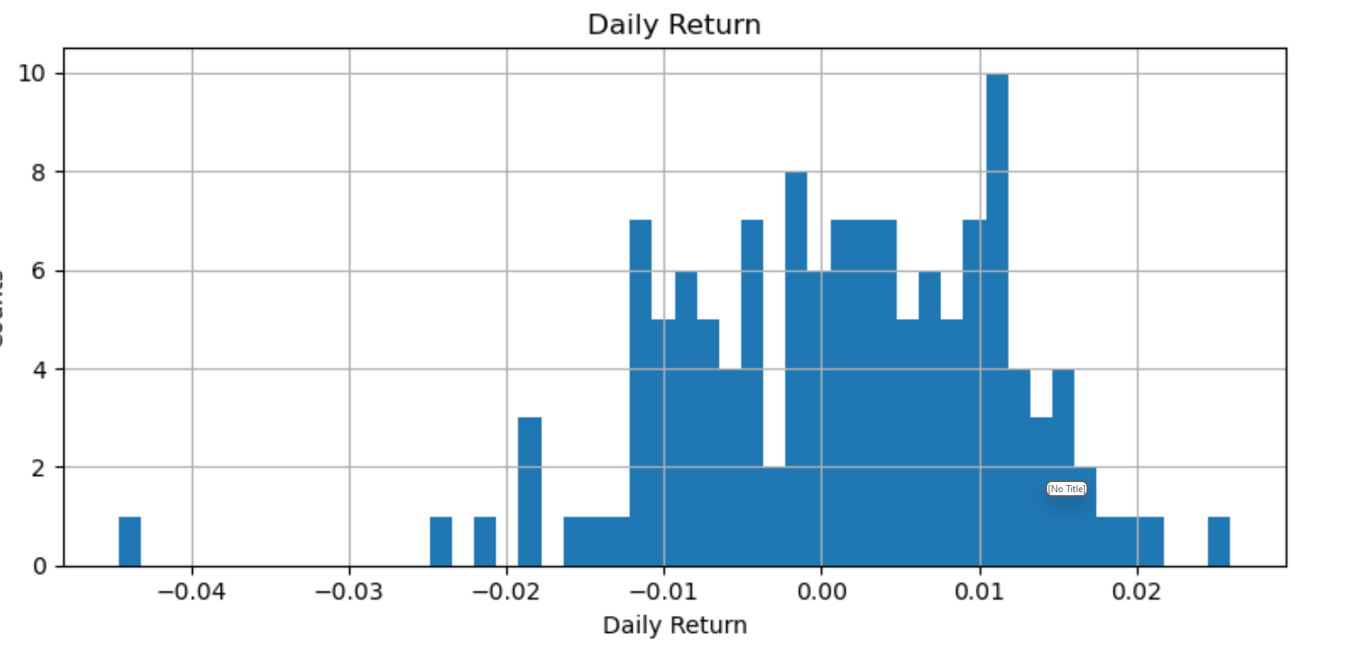
Exploratory Data Analysis (EDA)
Stock Recommendation:
Ticker list for US:
AAPL, NVDA, MSFT, GOOG, AMZN, META, TSLA, WMT, JPM, XOM, HD, PG, JNJ, BAC, KO, NFLX, AMD, BABA, MCD, CSCO, IBM, GE, VZ, DIS, PFE, T, C, INTC, BA, F
Ticker list for AUS:
CBA.AX, ANZ.AX, WBC.AX, NAB.AX, BHP.AX, CSL.AX, TLS.AX, WOW.AX, QBE.AX, RIO.AX
Stock data for the last 6 months are used.
131 rows and 8 columns each stock

Slide 8
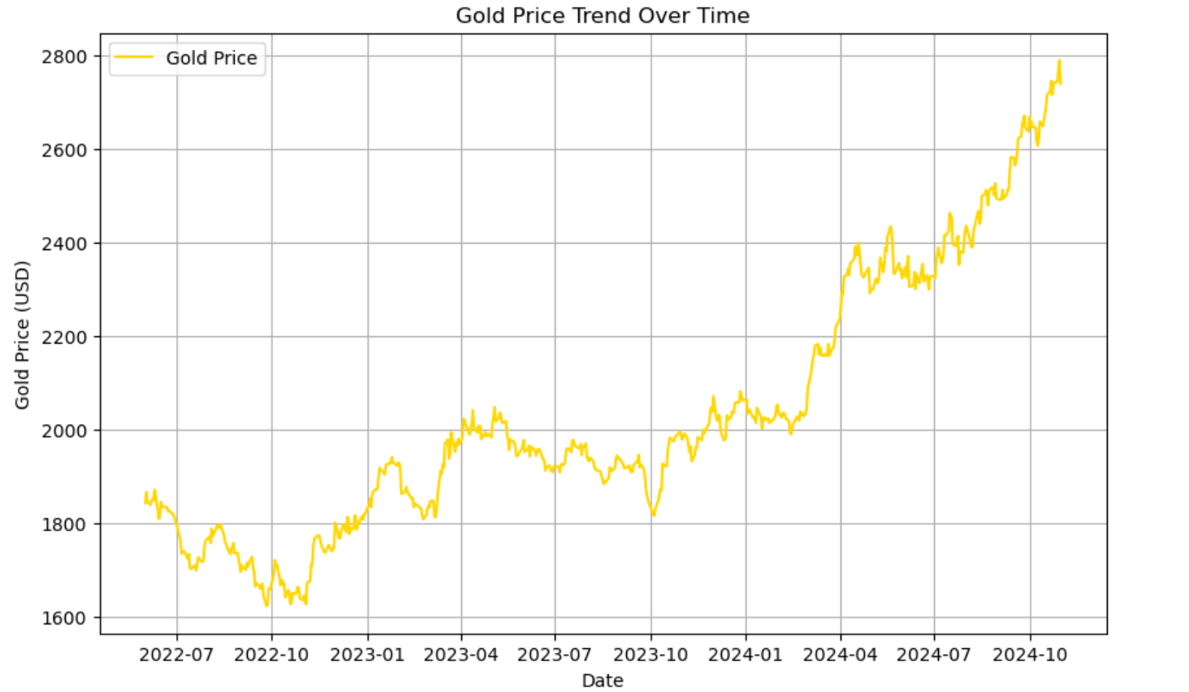
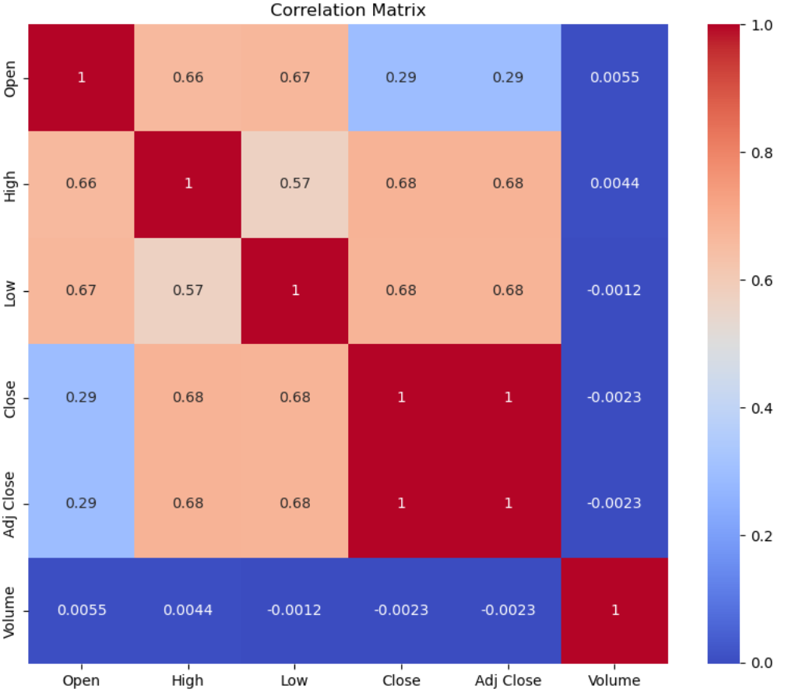
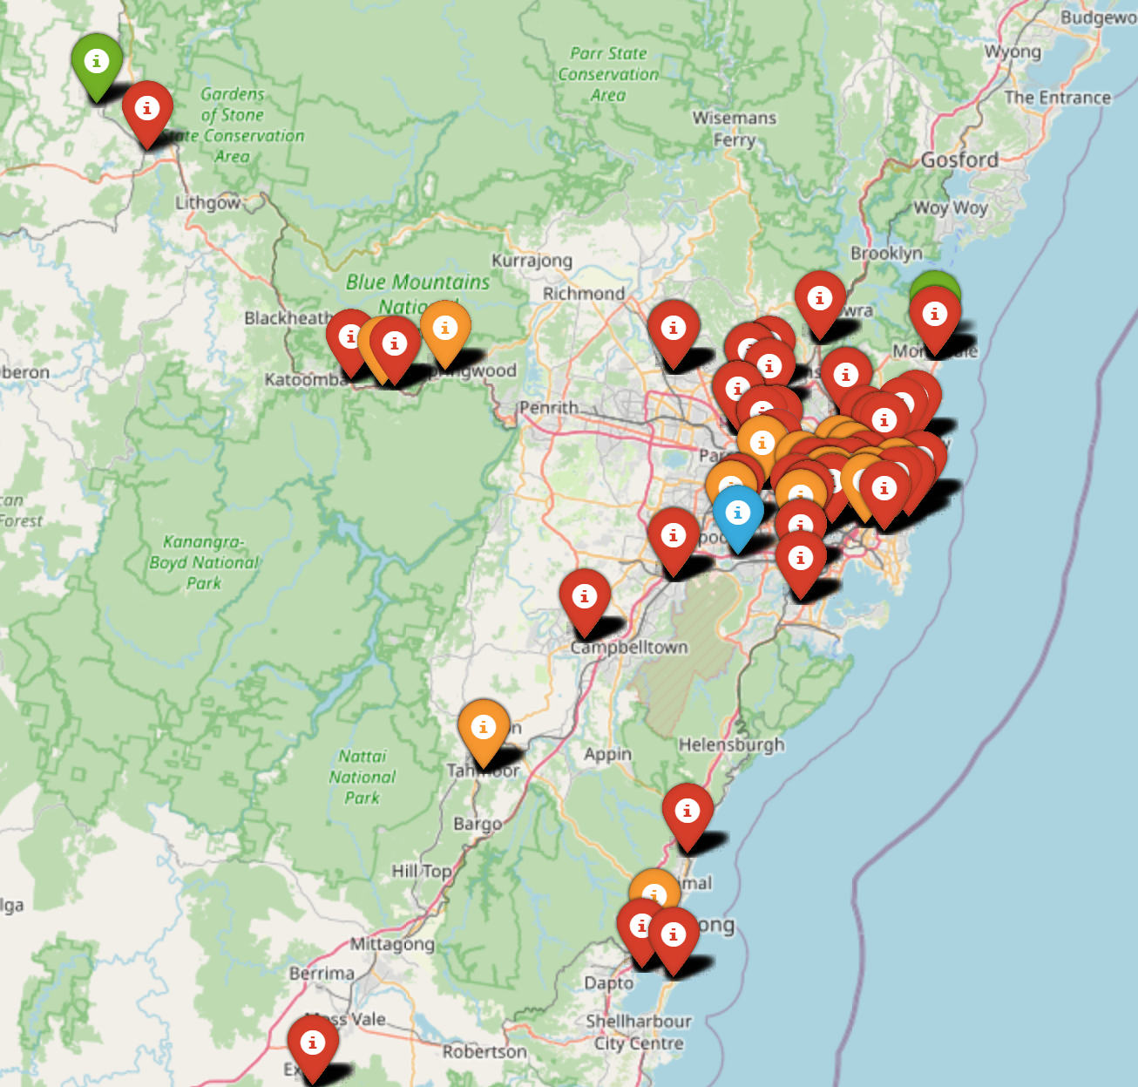
Used returns (percentage change) instead of raw prices for correlation analysis
Exploratory Data Analysis (EDA)
Gold Recommendation:
Gold_ticker used is GC=F
Data from 2022-2024(oct) used.
609 rows and 6 columns each stock
Real-estate Recommendation:
Data from 2022(Q1)-2024(Q1) used.
12,624 rows and 13 columns each stock.
After cleaning 9221 rows and 13 columns

Slide 9
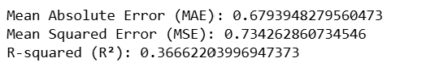
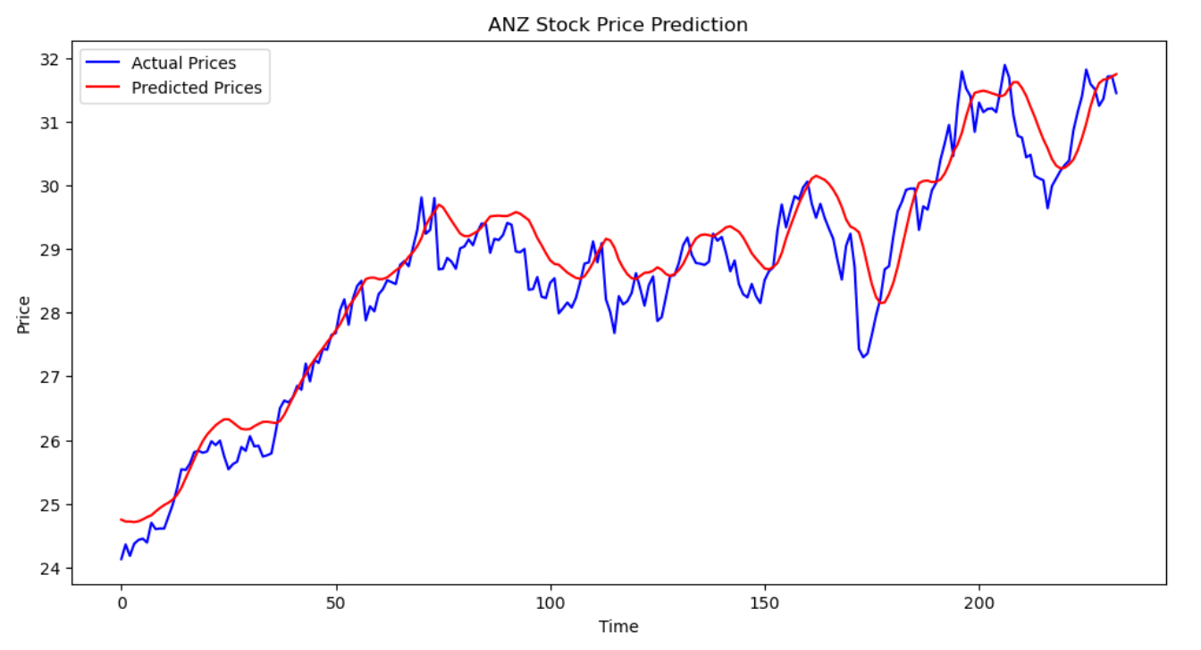
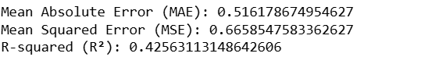

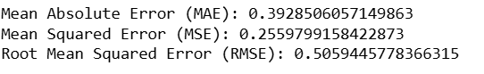
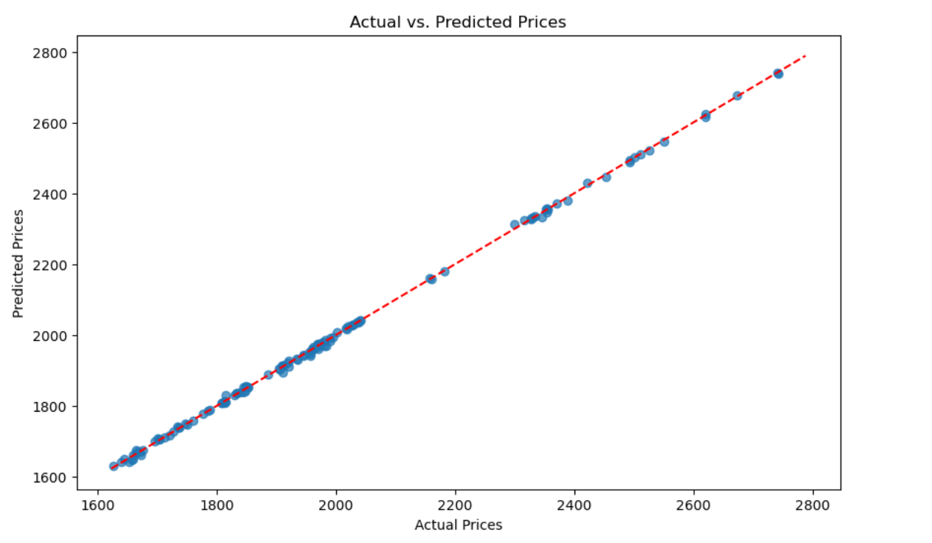
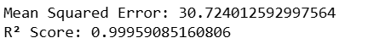
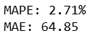

Best Model Actual vs predicted Stocks
Linear Regression
Modeling Approach
Stock Recommendation:
Models:
Linear Regression
RandomForestRegressor + Gridsearch
LSTM
Gold Recommendation:
Models:
Linear Regression
Prophet
Real-estate Recommendation:
Model:
Linear Regression
RandomForestRegressor + Gridsearch
Long short-term memory
Best Model Actual vs predicted Gold price
Linear Regression
Prophet
Linear Regression

Slide 10
Deployment and Practical Applications
Deployment Strategy:
Integration into a Stream lit web app with options for user inputs and real-time data updates.
User Inputs:
Sidebar navigation for easy access to different sections
Input forms for personalized recommendations (age, income, etc.)
Real-Time Data Updates:
Integration with yfinance for live stock prices
Economic news via API for current market trends
Challenges:
Acknowledge deployment limitations (e.g., need for continuous data updates).
Future Work and Improvements
Enhanced User Experience
UI/UX Design Upgrades
Improved visual design and intuitive navigation
Interactive features (tooltips, tutorials) for guidance
Personalization Features
Machine learning for tailored recommendations
Expanded Data Sources
Additional Financial Metrics
Incorporation of technical indicators and market sentiment
Broader Market Coverage
Inclusion of international stocks and commodities
Advanced Analytical Tools
Predictive Analytics
Sophisticated models for stock price forecasting
Portfolio Management Tools
Simulate and manage investment portfolios

Slide 11

Conclusion
The Investment Recommendation System provides personalized insights across stocks, gold, and real estate, empowering users to make informed investment decisions. Key features include:
Tailored Recommendations: Customized investment suggestions based on user profiles.
Real-Time Stock Data: Access to current prices, historical performance, and trade signals for US and AUS stocks.
Gold Insights: Up-to-date forecasts and market trends for gold investments.
Educational Resources: Guides on investment strategies and best practices.
Current Economic News: Timely updates on market influences.

Slide 12

Questions?
Thank you for your attention!
Disclaimer
All contents discussed do not constitute investment advice.

